Slide 1
Informed (Heuristic)
Search Strategies

Slide 2
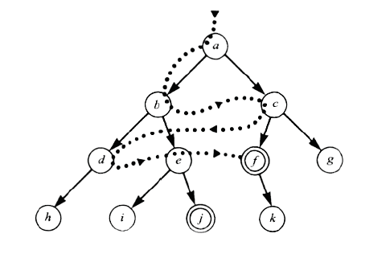
Using problem specific knowledge to aid searching
Without incorporating knowledge into searching, one can have no bias (i.e. a preference) on the search space.
Without a bias, one is forced to look everywhere to find the answer. Hence, the complexity of uninformed search is intractable.
Search everywhere!!

Slide 3
Using problem specific knowledge to aid searching
With knowledge, one can search the state space as if he was given “hints” when exploring a maze.
  Heuristic information in search = Hints
Leads to dramatic speed up in efficiency.
A
B
C
D
E
Search only in this subtree!!
F
G
H
I
J
K
L
M
N
O

Slide 4
More formally, why heuristic functions work?
In any search problem where there are at most b choices at each node and a depth of d at the goal node, a naive search algorithm would have to, in the worst case, search around O(b^{d}) nodes before finding a solution (Exponential Time Complexity).
Heuristics improve the efficiency of search algorithms by reducing the effective branching factor from b to (ideally) a low constant b* such that
  1 =< b* << b

Slide 5
Heuristic Functions
A heuristic function is a function f(n) that gives an estimation on the “cost” of getting from node n to the goal state – so that the node with the least cost among all possible choices can be selected for expansion first.
Three approaches to defining f:
  f measures the value of the current state (its “goodness”)
  f measures the estimated cost of getting to the goal from the current state:
    f(n) = h(n) where h(n) = an estimate of the cost to get from n to a goal
  f measures the estimated cost of getting to the goal state from the current state and the cost of the existing path to it. Often, in this case, we decompose f:
    f(n) = g(n) + h(n) where g(n) = the cost to get to n (from initial state)

Slide 6
Approach 1: f Measures the Value of the Current State
Usually the case when solving optimization problems
  Finding a state such that the value of the metric f is optimized
Often, in these cases, f could be a weighted sum of a set of component values:
  N-Queens
    Example: the number of queens under attack …
  Data mining
    Example: the “predictive-ness” (a.k.a. accuracy) of a rule discovered

Slide 7
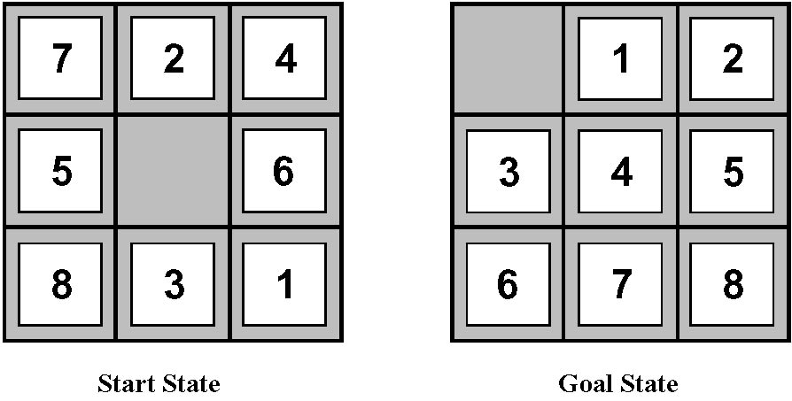
Approach 2: f Measures the Cost to the Goal
A state X would be better than a state Y if the estimated cost of getting from X to the goal is lower than that of Y – because X would be closer to the goal than Y
8–Puzzle
h₁: The number of misplaced tiles (squares with number).
h₂: The sum of the distances of the tiles from their goal positions.

Slide 8
Approach 3: f measures the total cost of the solution path (Admissible Heuristic Functions)
A heuristic function f(n) = g(n) + h(n) is admissible if h(n) never overestimates the cost to reach the goal.
  Admissible heuristics are “optimistic”: “the cost is not that much …”
However, g(n) is the exact cost to reach node n from the initial state.
Therefore, f(n) never over-estimate the true cost to reach the goal state through node n.
Theorem: A search is optimal if h(n) is admissible.
  I.e. The search using h(n) returns an optimal solution.
Given h₂(n) > h₁(n) for all n, it’s always more efficient to use h₂(n).
  h₂ is more realistic than h₁ (more informed), though both are optimistic.

Slide 9
Traditional informed search strategies
Greedy Best first search
  “Always chooses the successor node with the best f value” where f(n) = h(n)
  We choose the one that is nearest to the final state among all possible choices
A* search
  Best first search using an “admissible” heuristic function f that takes into account the current cost g
  Always returns the optimal solution path

Slide 10
Informed Search Strategies
Best First Search

Slide 11
An implementation of Best First Search
function BEST-FIRST-SEARCH (problem, eval-fn)
returns a solution sequence, or failure
queuing-fn = a function that sorts nodes by eval-fn
  return GENERIC-SEARCH (problem,queuing-fn)

Slide 12
Informed Search Strategies
Greedy Search
eval-fn: f(n) = h(n)

Slide 13
Greedy Search
Start
State | Heuristic: h(n)
A | 366
B | 374
C | 329
D | 244
E | 253
F | 178
G | 193
H | 98
I | 0
A
75
118
140
B
C
111
E
D
80
99
G
F
97
H
211
101
I
Goal
f(n) = h (n) = straight-line distance heuristic

Slide 14
Greedy Search
Start
State | Heuristic: h(n)
A | 366
B | 374
C | 329
D | 244
E | 253
F | 178
G | 193
H | 98
I | 0
A
75
118
140
B
C
111
E
D
80
99
G
F
97
H
211
101
I
Goal
f(n) = h (n) = straight-line distance heuristic

Slide 15
Greedy Search
Start
State | Heuristic: h(n)
A | 366
B | 374
C | 329
D | 244
E | 253
F | 178
G | 193
H | 98
I | 0
A
75
118
140
B
C
111
E
D
80
99
G
F
97
H
211
101
I
Goal
f(n) = h (n) = straight-line distance heuristic

Slide 16
Greedy Search
Start
State | Heuristic: h(n)
A | 366
B | 374
C | 329
D | 244
E | 253
F | 178
G | 193
H | 98
I | 0
A
75
118
140
B
C
111
E
D
80
99
G
F
97
H
211
101
I
Goal
f(n) = h (n) = straight-line distance heuristic

Slide 17
Greedy Search
Start
State | Heuristic: h(n)
A | 366
B | 374
C | 329
D | 244
E | 253
F | 178
G | 193
H | 98
I | 0
A
75
118
140
B
C
111
E
D
80
99
G
F
97
H
211
101
I
Goal
f(n) = h (n) = straight-line distance heuristic

Slide 18
Greedy Search
Start
State | Heuristic: h(n)
A | 366
B | 374
C | 329
D | 244
E | 253
F | 178
G | 193
H | 98
I | 0
A
75
118
140
B
C
111
E
D
80
99
G
F
97
H
211
101
I
Goal
f(n) = h (n) = straight-line distance heuristic

Slide 19
Greedy Search
Start
State | Heuristic: h(n)
A | 366
B | 374
C | 329
D | 244
E | 253
F | 178
G | 193
H | 98
I | 0
A
75
118
140
B
C
111
E
D
80
99
G
F
97
H
211
101
I
Goal
f(n) = h (n) = straight-line distance heuristic

Slide 20
Greedy Search
Start
State | Heuristic: h(n)
A | 366
B | 374
C | 329
D | 244
E | 253
F | 178
G | 193
H | 98
I | 0
A
75
118
140
B
C
111
E
D
80
99
G
F
97
H
211
101
I
Goal
f(n) = h (n) = straight-line distance heuristic

Slide 21
Greedy Search
Start
State | Heuristic: h(n)
A | 366
B | 374
C | 329
D | 244
E | 253
F | 178
G | 193
H | 98
I | 0
A
75
118
140
B
C
111
E
D
80
99
G
F
97
H
211
101
I
Goal
f(n) = h (n) = straight-line distance heuristic

Slide 22
Greedy Search
Start
State | Heuristic: h(n)
A | 366
B | 374
C | 329
D | 244
E | 253
F | 178
G | 193
H | 98
I | 0
A
75
118
140
B
C
111
E
D
80
99
G
F
97
H
211
101
I
Goal
f(n) = h (n) = straight-line distance heuristic

Slide 23
Greedy Search: Tree Search
A
Start
State | Heuristic: h(n)
A | 366
B | 374
C | 329
D | 244
E | 253
F | 178
G | 193
H | 98
I | 0
118
75
[329]
140
[374]
B
C
[253]
E
80
99
[193]
[178]
G
F
[366]
A
211
[253]
I
[0]
E
Goal
Path cost(A-E-F-I) = 253 + 178 + 0 = 431
dist(A-E-F-I) = 140 + 99 + 211 = 450

Slide 24
Greedy Search: Optimal ?
Start
State | Heuristic: h(n)
A | 366
B | 374
C | 329
D | 244
E | 253
F | 178
G | 193
H | 98
I | 0
A
75
118
140
B
C
111
E
D
80
99
G
F
97
H
211
101
I
Goal
f(n) = h (n) = straight-line distance heuristic
dist(A-E-G-H-I) =140+80+97+101=418

Slide 25
Greedy Search: Complete ?
Start
State | Heuristic: h(n)
A | 366
B | 374
** C | 250
D | 244
E | 253
F | 178
G | 193
H | 98
I | 0
A
75
118
140
B
C
111
E
D
80
99
G
F
97
H
211
101
I
Goal
f(n) = h (n) = straight-line distance heuristic

Slide 26
Greedy Search: Tree Search
Start
State | Heuristic: h(n)
A | 366
B | 374
C | 250
D | 244
E | 253
F | 178
G | 193
H | 98
I | 0
A
75
118
[250]
140
[374]
B
C
[253]
E
111
[244]
D
Infinite Branch !
[250]
C
[244]
D

Slide 27
Greedy Search: Time and
Space Complexity ?
Start
A
75
Greedy search is not optimal.
Greedy search is incomplete without systematic checking of repeated states.
In the worst case, the Time and Space Complexity of Greedy Search are both O(b^{m})
Where b is the branching factor and m the maximum path length
118
140
B
C
111
E
D
80
99
G
F
97
H
211
101
I
Goal

